Slide 1
COMP 469
Chapter 2: Intelligent Agents
Lecture companion mirroring CS188 Introduction Part II
Core idea: design systems that perceive, decide, and act rationally in an environment.
Use this deck as readable speaker notes for the Chapter 2 agent model.
Based on UC Berkeley CS188 Lecture 1, Introduction Part II; aligned to AIMA Ch. 2.
Notes:
Today we move from the broad question “What is AI?” into the Chapter 2 design question: how do we build an intelligent system? The Berkeley Part II lecture frames this as rational-agent design. An agent perceives an environment through sensors, chooses an action using an agent program, and acts through actuators. Throughout this lecture, Pac-Man is a useful running example because students can see the environment, the percepts, the actions, and the consequences of decisions immediately.

Slide 2
What Can AI Do?
Use this as a quick class poll before defining agents.
Win against any human at chess or Go?
Play table tennis or drive safely?
Unload any dishwasher in any home?
Buy groceries on the web vs. in a store?
Translate speech in real time?
Write jokes, art, or prove new theorems?
Teaching move
Do not ask only whether AI “can” do something. Ask what the environment is like, what the agent can perceive, what actions are available, and how success is measured.
Based on UC Berkeley CS188 Lecture 1, Introduction Part II; aligned to AIMA Ch. 2.
Chapter 2: Intelligent Agents
Notes:
Start with the Berkeley-style quiz. Ask students which tasks they think current AI can do reliably. The purpose is not to settle every item. The purpose is to make students notice that task difficulty depends on the environment. Chess and Go are hard intellectually but have clean rules, full state representation, and limited actions. A dishwasher in any home is physically messy, partially observable, and highly variable. Unknown city streets involve other agents, uncertainty, safety constraints, and real-time decision making. This naturally leads into Chapter 2: to design an AI system, we first define the agent, its environment, its percepts, its actions, and the performance measure.

Slide 3
From Capability Claims to Agent Design
A capability claim is incomplete until the task environment is specified.
Task
Percepts
Actions
Success
What is the agent trying to do?
What information can it receive?
What choices can it make?
What counts as doing well?
Chapter 2 answer: represent the system as an agent embedded in an environment.
Based on UC Berkeley CS188 Lecture 1, Introduction Part II; aligned to AIMA Ch. 2.
Chapter 2: Intelligent Agents
Notes:
This slide is the bridge from the Berkeley capability quiz to the textbook's agent framework. When students say that an AI can play chess, drive, translate, or write, push them to specify the task. What does the system observe? What can it do? How do we score success? This is the same conceptual move Chapter 2 makes. AI is not just “a program that is smart.” It is an agent operating in an environment. Once we define the task environment, we can reason about what kind of agent program is appropriate.

Slide 4
A Rational-Agent Perspective
Should we make machines that...
Think like people?
Think rationally?
Act like people?
Act rationally?
Course focus: act rationally
Based on UC Berkeley CS188 Lecture 1, Introduction Part II; aligned to AIMA Ch. 2.
Chapter 2: Intelligent Agents
Notes:
This is the four-approaches idea from Chapter 1, but Part II uses it to frame Chapter 2. The Berkeley lecture circles “act rationally.” In this course, we are not primarily trying to copy human thought processes or imitate human behavior. We are designing agents that choose actions that work. This is why the rational-agent model becomes the practical foundation for the rest of the course. It gives us a standard: given percepts, actions, and goals, what action should the agent take?

Slide 5
This Course: Designing Rational Agents
An agent is an entity that perceives and acts.
A rational agent selects actions that maximize expected utility.
The percepts, environment, and action space determine the correct technique.
The course teaches how to recognize which technique fits which problem.
Percepts
Agent
?
Environment
Actions
Based on UC Berkeley CS188 Lecture 1, Introduction Part II; aligned to AIMA Ch. 2.
Chapter 2: Intelligent Agents
Notes:
This is the key definition slide. Read it slowly. An agent perceives and acts. A rational agent chooses the action that maximizes expected utility. Expected utility means the best expected outcome when there is uncertainty. The word expected matters because many AI settings are not deterministic. The same decision may have different results depending on hidden state, randomness, other agents, or noisy sensors. The Berkeley lecture also emphasizes that the characteristics of the task determine the technique. A search problem, a game, a probability problem, an MDP, and a learning problem all become different ways of selecting rational actions under different assumptions.

Slide 6
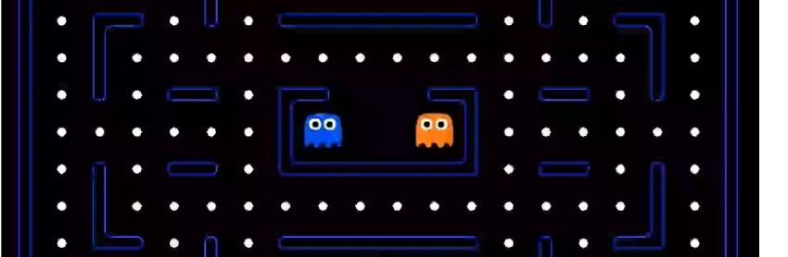
Pac-Man as an Agent
Running example: the agent observes the maze state, evaluates actions, and moves.
Pac-Man is useful because the environment, percepts, legal actions, rewards, and failures are visible.
Based on UC Berkeley CS188 Lecture 1, Introduction Part II; aligned to AIMA Ch. 2.
Chapter 2: Intelligent Agents
Notes:
Use Pac-Man as the classroom anchor. Pac-Man is the agent. The maze, dots, power pellets, walls, and ghosts are the environment. The agent's percepts are the information it receives: where it is, where the dots are, what legal moves exist, and where the ghosts are if that information is available. Its actions are movement choices such as north, south, east, west, or stop. Its performance measure can be score, survival, pellets eaten, time, or some combination. When you run your autonomous Pac-Man demo, tell students that the code is implementing this same agent model.

Slide 7
Agents and Environments
Agent
Percepts
Sensors
?
Environment
Actuators
Actions
The agent function maps percept sequences to actions.
The agent program implements that function on a machine.
The environment responds to the agent’s actions.
Based on UC Berkeley CS188 Lecture 1, Introduction Part II; aligned to AIMA Ch. 2.
Chapter 2: Intelligent Agents
Notes:
This is the formal Chapter 2 model. The agent receives percepts from the environment through sensors. It sends actions back to the environment through actuators. The important textbook distinction is between the agent function and the agent program. The agent function is the abstract mapping from percept history to action. The agent program is the concrete implementation that runs on hardware. In Pac-Man, the function says what move to choose given the percept history. The program is the Python code that computes the move.

Slide 8
Agent Function vs. Agent Program
Agent function
Abstract mapping from percept sequence to action
Agent program
Executable code that implements the mapping
Architecture
Machine or platform the program runs on
Teaching phrase: function is the “what”; program is the “how.”
Based on UC Berkeley CS188 Lecture 1, Introduction Part II; aligned to AIMA Ch. 2.
Chapter 2: Intelligent Agents
Notes:
Students often confuse the agent function with the agent program. Use this wording: the function is the what; the program is the how. The agent function is a mathematical description of behavior: for this history of percepts, choose this action. The agent program is the code that computes that action. The same function could theoretically be implemented in Python, Java, or hardware. The architecture is the machine or platform running the program. This distinction matters later when we discuss limitations. A complete lookup table may define an agent function in principle, but it may be impossible to store or compute in practice.

Slide 9
Agent Design Depends on the Environment
Partially observable
=>
Needs memory / internal state
Stochastic
=>
Plans for contingencies
Multi-agent
=>
May need strategic or randomized behavior
Static
=>
Can spend time computing a decision
Continuous time
=>
Needs a continuously operating controller
Unknown physics
=>
Needs exploration
Unknown performance measure
=>
Needs human feedback or preference learning
Based on UC Berkeley CS188 Lecture 1, Introduction Part II; aligned to AIMA Ch. 2.
Chapter 2: Intelligent Agents
Notes:
This slide directly mirrors the Berkeley “Agent design” slide. The environment determines the design. If the environment is partially observable, the agent cannot simply react to the current percept; it needs memory. If the environment is stochastic, the agent must reason about possible outcomes. If it is multi-agent, the agent must consider other agents and may need to behave unpredictably. If the environment is static, the agent has time to compute. If it is continuous-time, the agent may need a controller rather than a one-shot decision. If the physics or rules are unknown, the agent needs exploration. If the performance measure is unknown, the agent may need to observe or interact with a human principal.

Slide 10
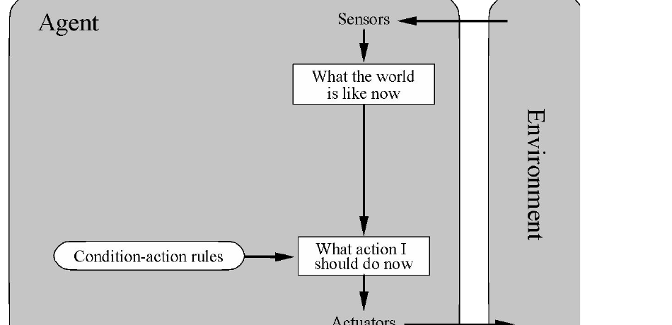
Simple Reflex Agents
Use condition-action rules.
Look only at the current percept.
Work best in fully observable, simple environments.
Fail when important state is hidden or history matters.
Rule form: if condition, then action.
Based on UC Berkeley CS188 Lecture 1, Introduction Part II; aligned to AIMA Ch. 2.
Chapter 2: Intelligent Agents
Notes:
A simple reflex agent is the first agent type in Chapter 2. It does not plan ahead and does not maintain a rich model of the world. It checks the current percept and fires a condition-action rule. For example, “if dirt is present, suck” in a vacuum world, or “if a dot is next to Pac-Man, move toward it” in a simplified Pac-Man world. This is easy to understand and fast to compute. The limitation is that it only sees the current situation. If a good decision depends on previous percepts or hidden state, a simple reflex agent is not enough.

Slide 11
Pac-Man Agent Program in Python
A minimal reflex agent can be written as one rule:
class GoWestAgent(Agent):
def getAction(self, percept):
if Directions.WEST in percept.getLegalPacmanActions():
return Directions.WEST
else:
return Directions.STOP
This is an agent program. It maps a percept to an action.
Based on UC Berkeley CS188 Lecture 1, Introduction Part II; aligned to AIMA Ch. 2.
Chapter 2: Intelligent Agents
Notes:
This slide is useful because it makes the agent program concrete. The GoWestAgent checks the current percept. If west is a legal action, it returns west. Otherwise it stops. This is not a good Pac-Man player, but it is a valid agent program. It has sensors indirectly through the percept object, and it acts by returning a direction. Ask students: what is missing? It does not know the goal, it does not compare alternatives, it does not avoid ghosts, and it does not remember anything. That sets up why we need more sophisticated agent designs.

Slide 12
Better Reflex Rule: Eat an Adjacent Dot
A slightly better reflex agent checks nearby legal moves.
Still reflex: no planning horizon.
Improves only by adding more rules.
Can become brittle as the environment gets more complex.
for action in legal_actions:
next_square = successor_position(action)
if next_square contains food:
return action
return default_safe_action
This is where students should see the limitation of “just add if-statements.”
Based on UC Berkeley CS188 Lecture 1, Introduction Part II; aligned to AIMA Ch. 2.
Chapter 2: Intelligent Agents
Notes:
Now improve the reflex rule. Instead of always going west, the agent checks whether any adjacent square has food and moves there. This is more sensible, but it is still a simple reflex agent. It does not plan a path to distant food, it does not evaluate future ghost positions, and it does not reason about power pellets beyond what appears in the current percept. This is a good moment to ask students: how many special cases would we need before this agent behaves well? The answer becomes large quickly.

Slide 13
Limits of Reflex Agents
Can we extend a reflex agent to behave well in all Pac-Man environments?
Not reliably, because some relevant information may be hidden.
Example: power-pellet duration may not be fully observable.
A lookup table is possible in principle, but can be infeasibly large.
Key point: current percept alone is not always enough.
Based on UC Berkeley CS188 Lecture 1, Introduction Part II; aligned to AIMA Ch. 2.
Chapter 2: Intelligent Agents
Notes:
The Berkeley lecture asks whether a reflex agent could, in principle, behave well in all standard Pac-Man environments. The answer is no if Pac-Man is not fully observable. Power-pellet duration is a good example. The agent may need to remember when the pellet was eaten to know whether ghosts are still edible. Without memory, the current percept may be ambiguous. In a fully observable setting, a huge lookup table could map every possible state to an action, but that is not a practical design. This prepares students for model-based agents, goal-based agents, utility-based agents, and learning agents.

Slide 14
Chapter 2 Roadmap
Simple reflex
Condition-action rules
Immediate reactions
Model-based reflex
Internal state
Partially observable worlds
Goal-based
Search/planning
Choose actions that reach goals
Utility-based
Expected utility
Compare tradeoffs under uncertainty
Learning agent
Improvement from experience
Adapt when model or rules are incomplete
Part II of the Berkeley lecture gets you through the agent model and simple reflex agents; Chapter 2 continues into richer agent architectures.
Based on UC Berkeley CS188 Lecture 1, Introduction Part II; aligned to AIMA Ch. 2.
Chapter 2: Intelligent Agents
Notes:
This is where you connect the Berkeley Part II lecture to the full Chapter 2 structure. Part II gets us through the central agent definition, environment-driven design, and simple reflex agents. The textbook then broadens the design space. Model-based reflex agents maintain internal state. Goal-based agents use goals and often require search. Utility-based agents compare outcomes, especially when multiple acceptable goals exist or uncertainty matters. Learning agents improve their behavior from experience. This slide prevents students from thinking that all agents are simple reflex agents.

Slide 15
Classroom Demo: Autonomous Pac-Man
Ask students to identify the agent components in the running code.
What are the sensors/percepts?
What are the actuators/actions?
What is the performance measure?
Is the agent reflex, goal-based, utility-based, or mixed?
What hidden state or memory would improve it?
Transition: search algorithms are one way to make goal-based agents act rationally.
Based on UC Berkeley CS188 Lecture 1, Introduction Part II; aligned to AIMA Ch. 2.
Chapter 2: Intelligent Agents
Notes:
End this lecture with the autonomous Pac-Man demo. Ask students to map the code to the Chapter 2 vocabulary. The sensors are the information the game exposes to the agent: position, pellets, ghosts, and legal moves. The actuators are movement commands. The performance measure is score, survival, and pellet completion. The agent you built is not purely reflex because it calculates distances and utility scores, but it is still limited. It does not perfectly predict the future or maintain a complete model. This makes a natural transition into search: if an agent has a goal, such as reaching a pellet, it can search over possible future action sequences.

